Slide 1
Sending Emails using Python and Smtp server Api
Requirements:
Python above 3.7
Sender email

Slide 2
Packages
1. smtplib
2. ssl
3. email
Note: all these pacakges are preinstalled by python no need for installtion manually

Slide 3
Step-1→
Open google.com
Go to Manage your Google account section
In security section
Search for “app passwords”
Enetr password and create an password copy that password and save in a file

Slide 4
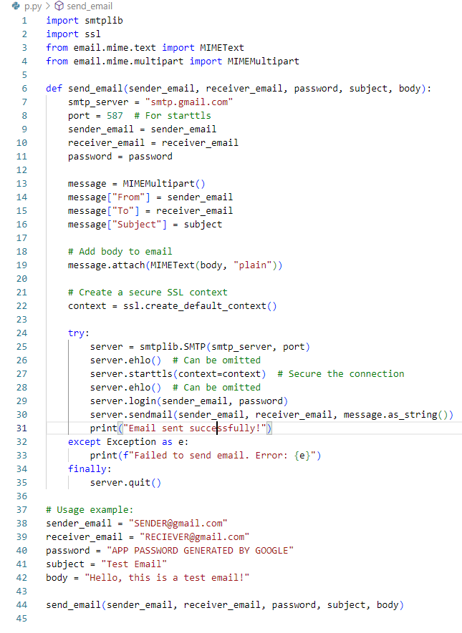
Step-2→

Slide 5
Step-3→
Change the crediantials with your actual credentials
Run the sever

Slide 6
Congrats
You have success fully sent email using python and smtp api
Else:
If an error occurs check
Step-1
Or
Check your credentails
Thank you

